Slide 1
New York & New England Report 2019/20
Kiki Zinycz, Hurtkova

Slide 2
Plan and results for the year:
Cxodunu
Koliada
Andrivsky Vechir
Zumova Prohulka
Dobre Dilo…PT painting project
Trail maintenance at the Q
Connect with STPs
Create SOPs
1. CXODUNU:
*Dates were set and shared IN ADVANCE to meet 5x in the season.
We met as planned on 11/21, 1/16, 3/12, 5/14; 10/8 as a c/call.
I focused on keeping the admin minimal and actionable:
Agendas were sent prior to cxodunu;
Recaps and action items soon after.
The point was to keep on target, reduce chit chat, and ensure we are making solid plans to achieve our goals.

Slide 3
2. Koliada
Mini Koliada held on 1/3 in CT; raising $1500!
Format varies by year and interest. This is a small social event that helps
Raise some $.
Review if this is still a viable activity. Is there a more useful
or modern option? Ie: visit seniors, build snowmen, help stanitsias?
3. Andrivsky Vechir
This is no longer on our calendar as Stepovi Vidmy will be universally
Handling this and other pagan rituals like Ivana Kupala, going forward.
4. Zumova Prohulka (Our marquis event!)
Continues to be an amazing event.
We made improvements: updated registration form, ID badges for staff,
Bibs for kids, increased on-site admin team, added Ski Patrol briefing, added
Medical liason, etc to create a smooth operation and fun experience for the kids.
2021 probably on hold; or can hold VIRTUAL ZP.

Slide 4
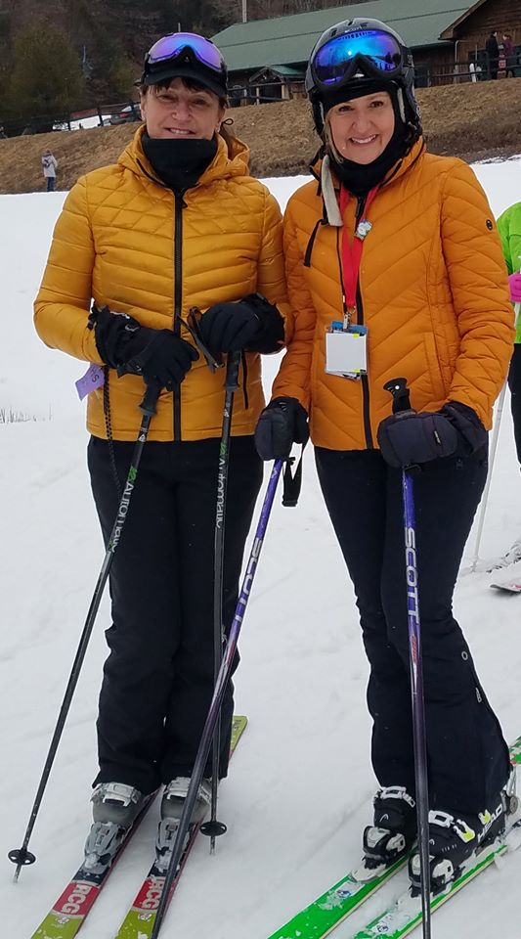
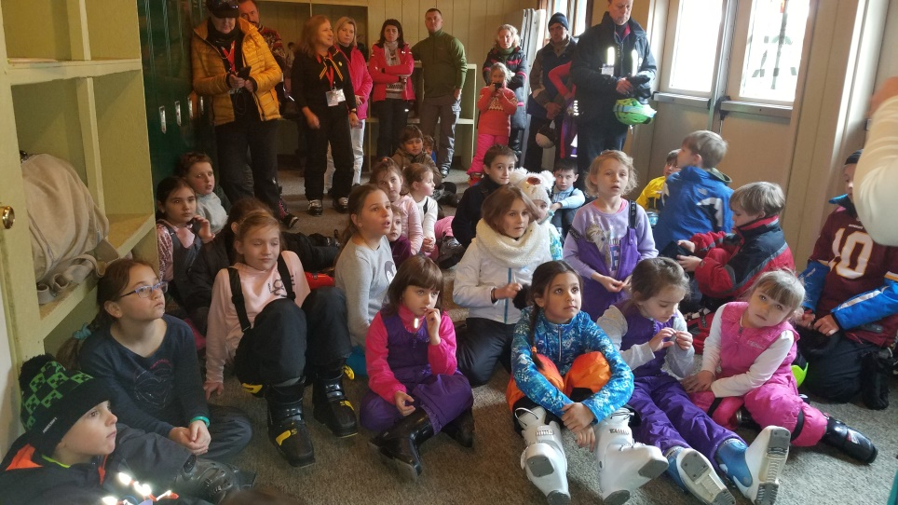
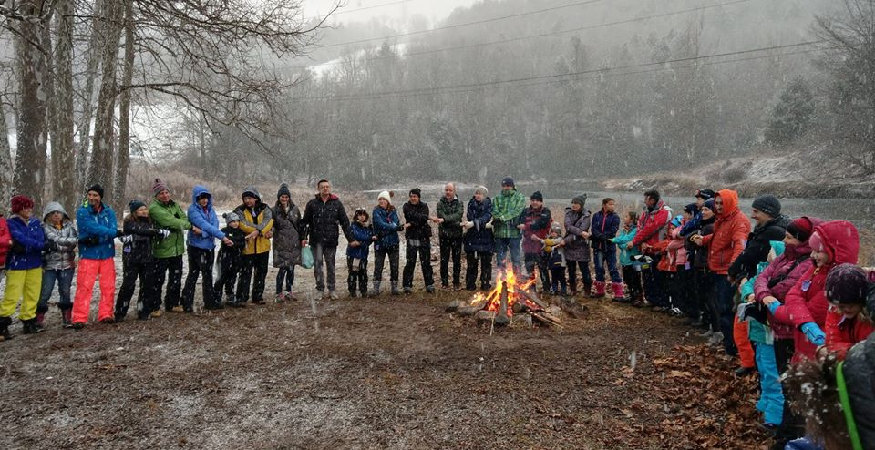

Slide 5
5. Dobre Dilo
Due to COVID shutdown, we decided to help VT with the PT building painting.
Great fun, a bit of hard work, but beautiful day and opportunity to get together!
We propose to add this to our annual calendar.
Decide if this should be KYRIN work or HURTOK.
SUGGEST to loop in STPs as a bonding project, and way to turn the
stewardship of PT to the STPs.
6. Trail Maintenance at the Q
On hold due to COVID. People like the idea, helps Kerhonkson stanitsia.
Can even be a weekend camp/retreat event open to other kurins, etc?
OR…shift our focus to VT as above.
7. Connect with STPs
Lets blame COVID for not allowing more physical connection this year.
However, going forward, see #5 and #6 above, along with local meetups and
Combining activities.
We need to begin the training and hand off responsibility…

Slide 6
8. Create SOPs
Implemented a calendar & standard for cxodunu and recaps
Created an SOP/checklist for ZP
Suggest same to set parameters and align efforts across hurtoks
Identify KPIs to guide our activities, whether ongoing or new
PROPOSALS:
Role clarity, ie Kyrin v. Hurtok work
Share information/schedules across hurtoks…whatchya gals doin’?
ZP as virtual option?
Update/revise our activities, ie koliada
Keep in touch program
CRITICAL…train up STPs and other members to take on responsibilities
Thanks ladies!
Let me know if you wanna do this again.

